Slide 1

Unit-2: Wireless Communication Technology PART-2 : Antennas and Propagation
Mobile Computing Wireless Communication
(MCWC)
GTU # 3170710
Prof.Swati R Sharma
Computer Engineering Department
swati.sharma@darshan.ac.in
(O) 9727747317

Slide 2
Antennas and Propagation

Looping
Topics to be covered-Antennas and Propagation
Antennas
Propagation Modes
Line-of Sight Transmission
Fading in the Mobile Environment

Slide 3
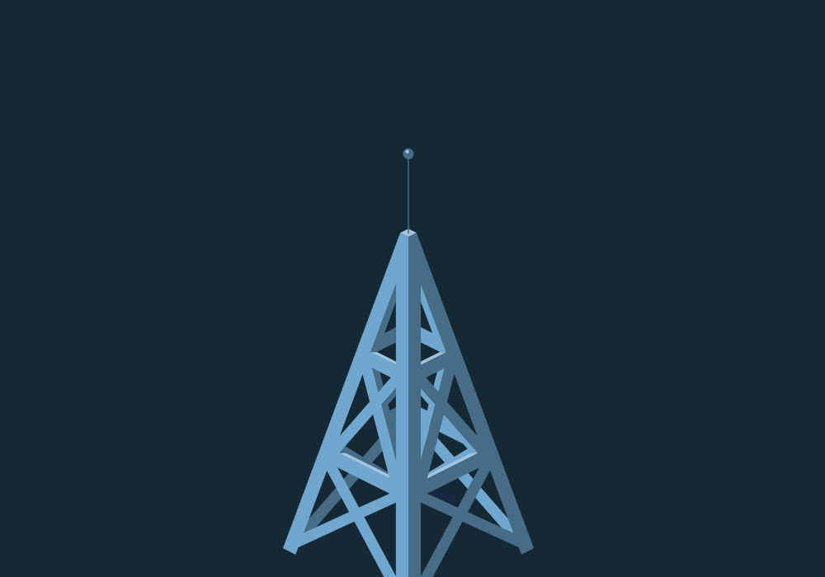
Antennas

Slide 4
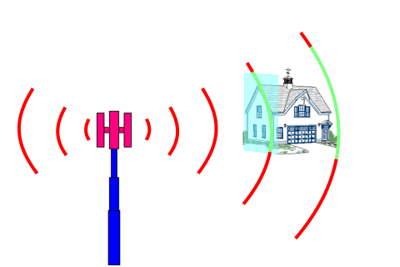
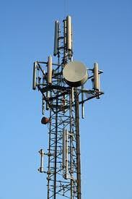
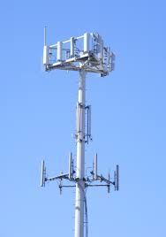
Antennas
An antenna is an electrical conductor or system of conductors
Transmission - radiates electromagnetic energy into space
For transmission of signal, radio-frequency electrical energy from the transmitter, is converted into electromagnetic energy by the antenna, and radiated into the surrounding environment (atmosphere, space, water)
Reception - collects electromagnetic energy from space
For reception of a signal, electromagnetic energy impinging on the antenna is converted into radio-frequency electrical energy and fed into the receiver.
Same frequency is used in both direction.
In two-way communication, the same antenna can be used for transmission and reception

Slide 5
Radiation Pattern

Slide 6
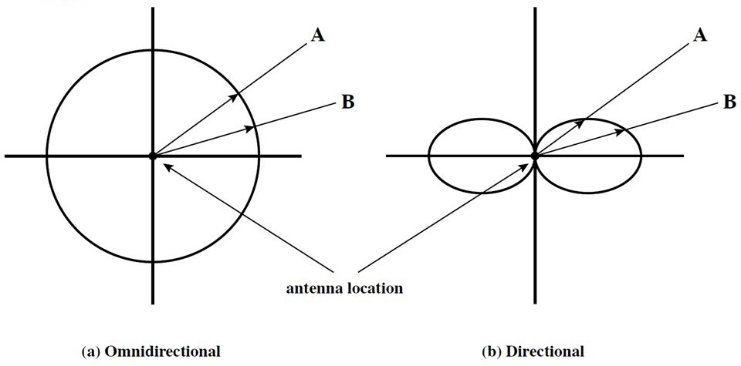
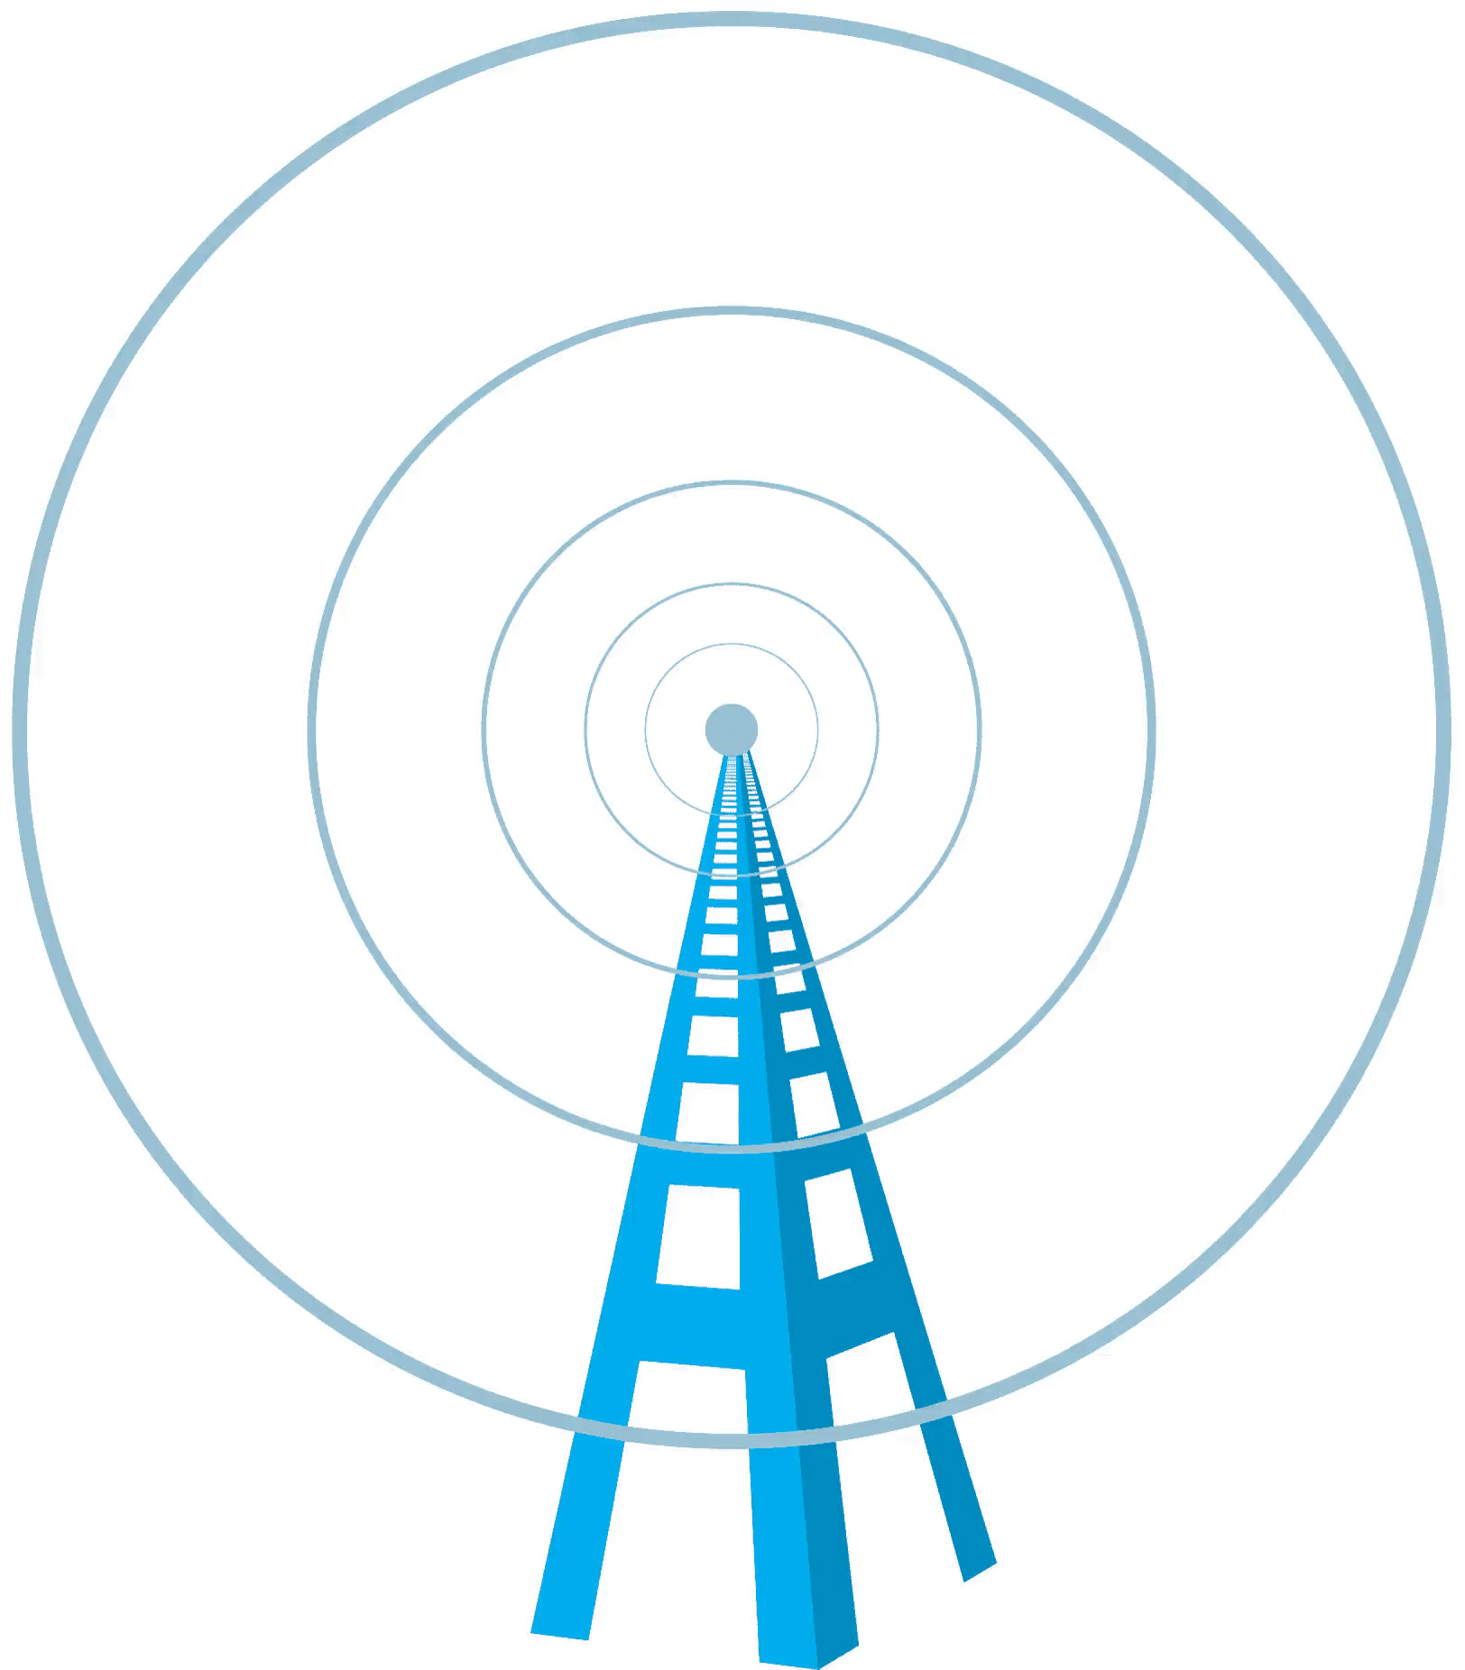
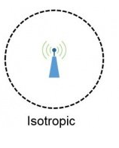
Radiation Pattern
An antenna will radiate power in all directions but, typically, does not perform equally well in all directions.
Radiation pattern
Graphical representation of radiation properties of an antenna
Depicted as two-dimensional cross section
The relative distance from the antenna position in each direction determines the relative power
The simplest pattern is produced by an idealized antenna known as the isotropic antenna.
radiates power in all directions equally.
Radiation pattern for the isotropic antenna is a sphere with the antenna at the centre.
The directional antenna in which the preferred direction of radiation is along.

Slide 7
Radiation Pattern
To determine the relative power in a given direction, a line is drawn from the antenna position at the appropriate angle, and the point of intercept with the radiation pattern is determined.
Figure(a) shows a comparison of two transmission angles, A and B, drawn on the two radiation patterns.
The isotropic antenna produces an omnidirectional radiation pattern of equal strength in all directions, so the A and B vectors are of equal length.
For the antenna pattern of Figure(b), the B vector is longer than the A vector, indicating that more power is radiated in the B direction than in the A direction, and the relative lengths of the two vectors are proportional to the amount of power radiated in the two directions.

Slide 8
Antenna Types

Slide 9
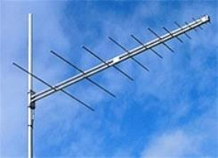
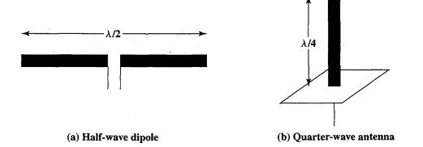
Antenna Types
Isotropic antenna (idealized)
Radiates power equally in all directions
Used to calculate gain of antennas
Dipole antennas
Half-wave dipole antenna (or Hertz antenna)
Quarter-wave vertical antenna (or Marconi antenna)

Slide 10
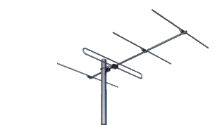
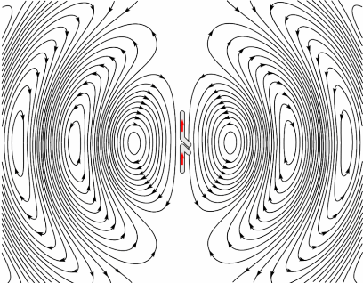
Dipole antenna
Dipole antennas Types
Half-wave dipole antenna (or Hertz antenna)
Quarter-wave vertical antenna (or Marconi antenna)
The length of the total wire, which is being used as a dipole, equals half of the wavelength (i.e., l = λ/2). Such an antenna is called as half-wave dipole antenna.
This is the most widely used antenna.
It is also known as Hertz antenna.

Slide 11
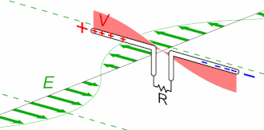
Dipole antenna
This antenna receives power from Radio Waves.
Here the electric field of the wave pushes the electrons in the antenna elements back & forth (shown in green color arrow), charging ends of the antenna alternatively (+ve and –ve).
Used in radio receivers and television receivers.

Slide 12
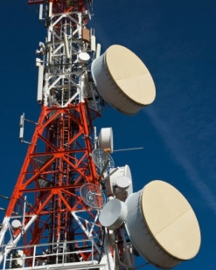
Parabolic Reflective Antenna

Slide 13
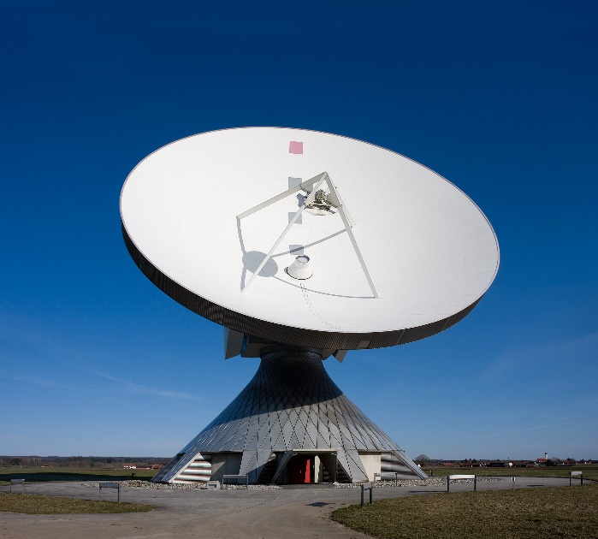
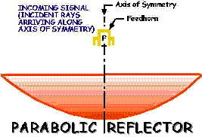
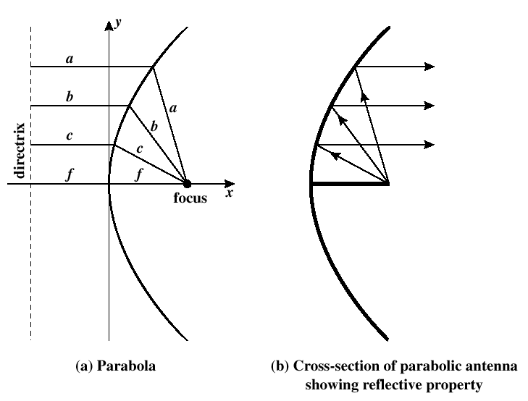
Parabolic Reflective Antenna
Parabolic Reflectors are Microwave antennas.
The frequency range used for the application of Parabolic reflector antennas is above 1MHz. These antennas are widely used for radio and wireless applications.
Application
Terrestrial microwave and satellite application
A parabola is the locus of all points equidistant from a fixed line and a fixed point not on the line. The fixed point is called the focus and the fixed line is called the directrix (Figure 5.4a).
If a parabola is revolved about its axis, the surface generated is called a paraboloid.

Slide 14
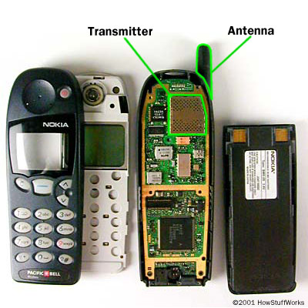
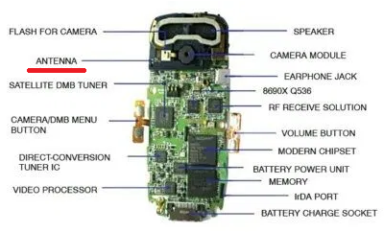
Mobile Embedded Antenna
Cell phone contains at least one antenna to transmit or receive radio signals. Modern cell phones contain more than one compact antennas. They may have more than one antennas, cellular antenna, wi-fi, Bluetooth, and GPS antenna. If any problem appears in an antenna, then, there will be no network in your mobile phone.

Slide 15
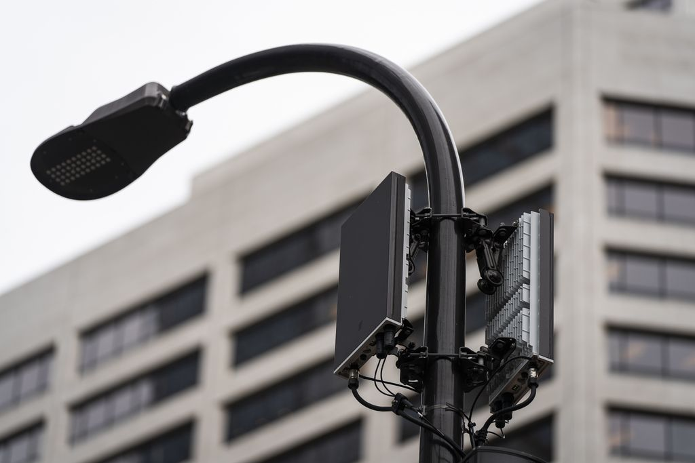
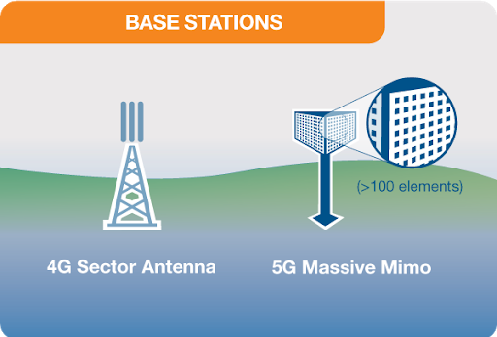
Base Station

Slide 16
Antenna Gain

Slide 17
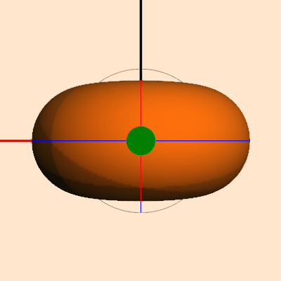
Antenna Gain-Isotropic Antenna

Slide 18
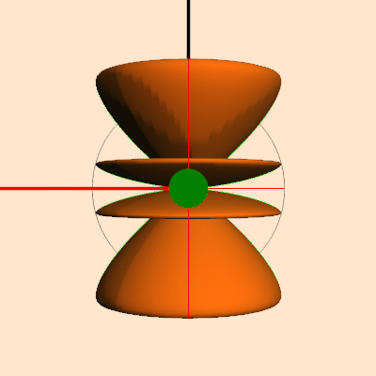
Antenna Gain-Directional Antenna

Slide 19

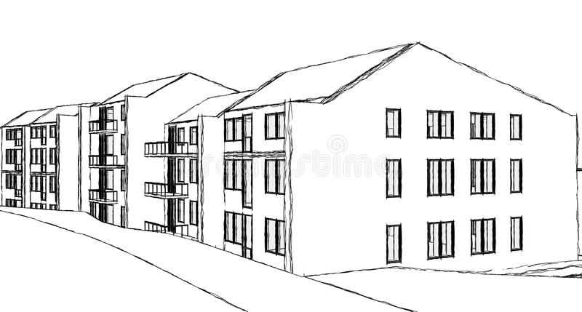
Input=1W
Output=1W
Isotropic antenna Gain= 0dB

Slide 20
Input=1W
Output=2W
Antenna Gain= 3dB

Slide 21
Input=1W
Output=4W
Antenna Gain= 6dB

Slide 22
Input=1W
Output=32W
Antenna Gain= 15dB

Slide 23
Antenna Gain
Input Power | Antenna Gain
1 unit | 0dB
2 unit(x2) | 3dB
4 unit(x2 of 3dB) | 6dB
32 unit(x8 of 6dB) | 15dB
1000 unit(x32 of 15dB) | 30dB

Slide 24
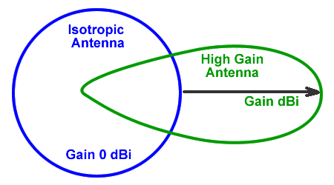
Antenna Gain
Antenna gain
A measure of the directionality of an antenna.
Antenna gain is an ability of the antenna to radiate more or less in any direction compared to a theoretical antenna.
Power output, in a particular direction, compared to that produced in any direction by a perfect omnidirectional antenna (isotropic antenna)
Gain is measured in decibals(dB)
Effective area
Related to physical size and shape of antenna
if an antenna could be made as a perfect sphere, it would radiate equally in all directions. Such an antenna is theoretically called an isotropic antenna
Omni antennas typically radiate with a gain of 2.1 dB over an isotropic antenna.
Directional antennas can be configured with gains up to more than 20 dB.
Antenna gain is most easily derived by considering all antennas as transmitting antennas.

Slide 25
Antenna Gain
Relationship between antenna gain and effective area
G = antenna gain
Ae = effective area
f = carrier frequency
c = speed of light (» 3 X10⁸ m/s)
λ = carrier wavelength

Slide 26
Antenna Gain
Type of antenna | Effective area | Power gain
Isotropic | ג²/4π | 1
Infinitesimal dipole or loop | 1.5λ²/4π | 1.5
Half-wave dipole | 1.64λ²/4π | 1.64
Horn, mouth area A | 0.81A | 10A/ λ²
Parabolic, face area A | 0.56A | 7A/ λ²
turnstile | 1.15λ²/4π | 1.15

Slide 27
Propagation Modes

Slide 28
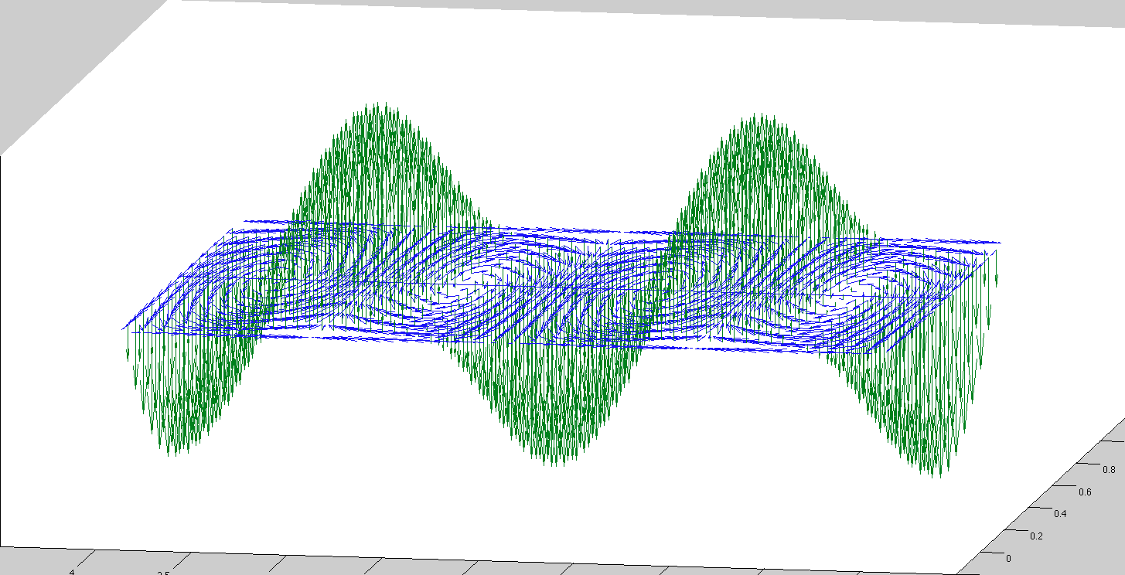
Propagation Modes
Propagation: The radiated power propagates in space in the form of electromagnetic waves.
The radiation and propagation of the radio waves cannot be seen
There are 3 types of propagation
Ground-wave propagation
Sky-wave propagation
Line-of-sight propagation

Slide 29
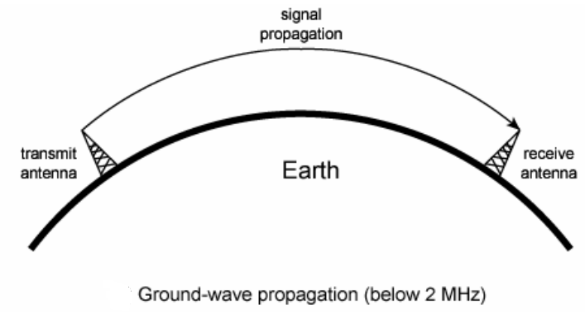
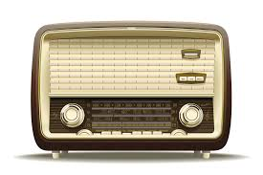
Ground-wave propagation
The EM waves leaves antenna and remains close to the earth surface.
It follows the curvature of the earth surface and uses lower frequency.
The ground wave propagation is strongest at low and medium frequency ranges i.e. between 30kHz and 3MHz.
While passing over the earth surface, the ground waves induce some current in to it. Thus they loose some energy due to absorption.
Due to diffraction EM wave tilt over the surface of the earth and this angle increases with distance and frequency so, ground wave propagation should be used up to MW (Medium Wave) frequency band.
E.g. AM FM Radio, TV broadcasting.

Slide 30
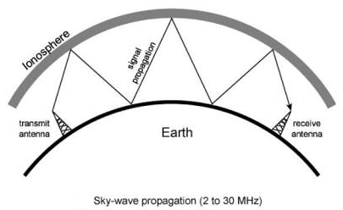
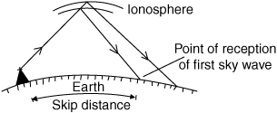
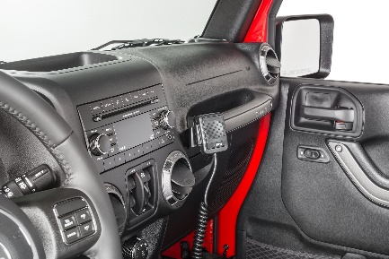
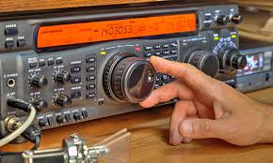
Sky-wave propagation
Signal reflected from ionized layer of atmosphere back down to earth
Signal can travel a number of hops, back and forth between ionosphere and earth’s surface
Ionosphere is the ionized layer around the Earth’s atmosphere, which is suitable for sky wave propagation.
Reflection effect caused by refraction
With this propa­gation mode, a signal can be picked up thousands of kilometres from the transmitter.
Examples
Amateur radio
CB radio
Notes:
Citizens band radio

Slide 31
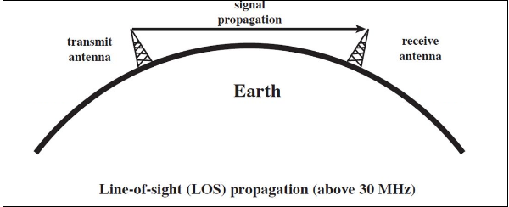
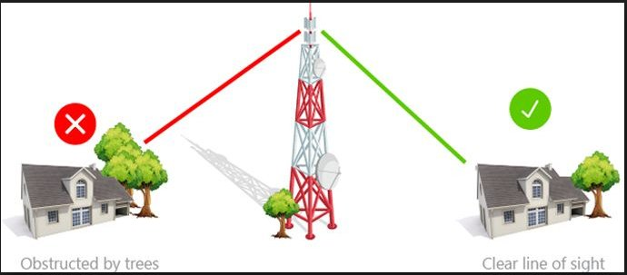
Line-of Sight Transmission
As the name implies, the wave travels a minimum distance of sight.
Which means it travels to the distance up to which a naked eye can see.
Ground communication - Antennas within effective line of site due to refraction.
Satellite communication - Signal above 30 MHz is not reflected by ionosphere.
Therefore it can be transmitted between an earth station and satellite.
We need to employ an amplifier/transmitter to amplify the signal and transmit again.
Application
Infrared transmission
Microwave transmission

Slide 32
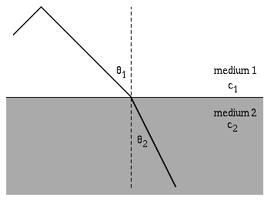
Line-of Sight Transmission
Refraction
Bending of microwaves by the atmosphere.
It depends on conditions, such as curvature of the earth.
Velocity of electromagnetic wave is a function of the density of the medium.
When wave changes their medium, their speed also changes.
Wave bends at the boundary between mediums.
Example: Speed of light (3 x 10⁸ m/s) is varies in a vacuum, in air, water, glass.

Slide 33
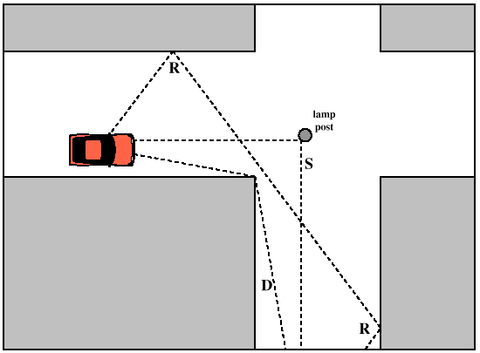
Multipath Propagation
Reflection – It occurs when signal encounters a surface that is large relative to the wavelength of the signal.
Diffraction – It occurs at the edge of an impenetrable body that is large compared to wavelength of radio wave.
Scattering – It occurs when incoming signal hits an object whose size in the order of the wavelength of the signal or less.

Slide 34
GTU Questions: Unit 2-Part 2
Sr. | Question | Marks | Year
1. | What is wave propagation? Discuss various modes of propagation with example. | 4 7 7 | Sum’19 Win’19 Sum’20
2. | List and explain the types of antenna in wireless network with their applications. | 4 | Win’20
3. | Define Radio propagation. List and explain propagation modes. | 3 | Win’20

Slide 35

References
Book: | Wireless Communications & Networks, Second Edition, William Stallings by Pearson
Web: | https://www.allaboutcircuits.com/technical-articles

Slide 36
Thank You

